Slide 1
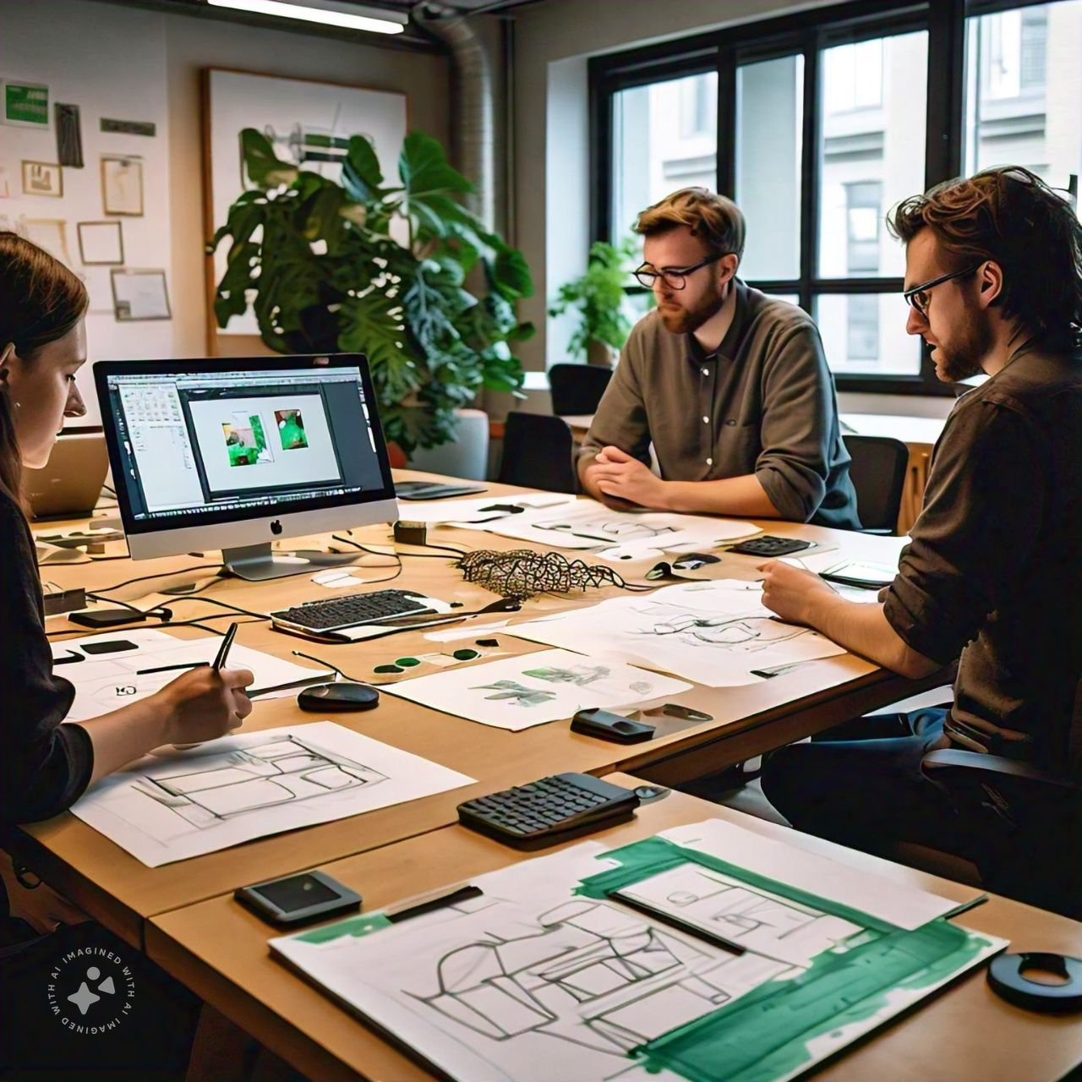
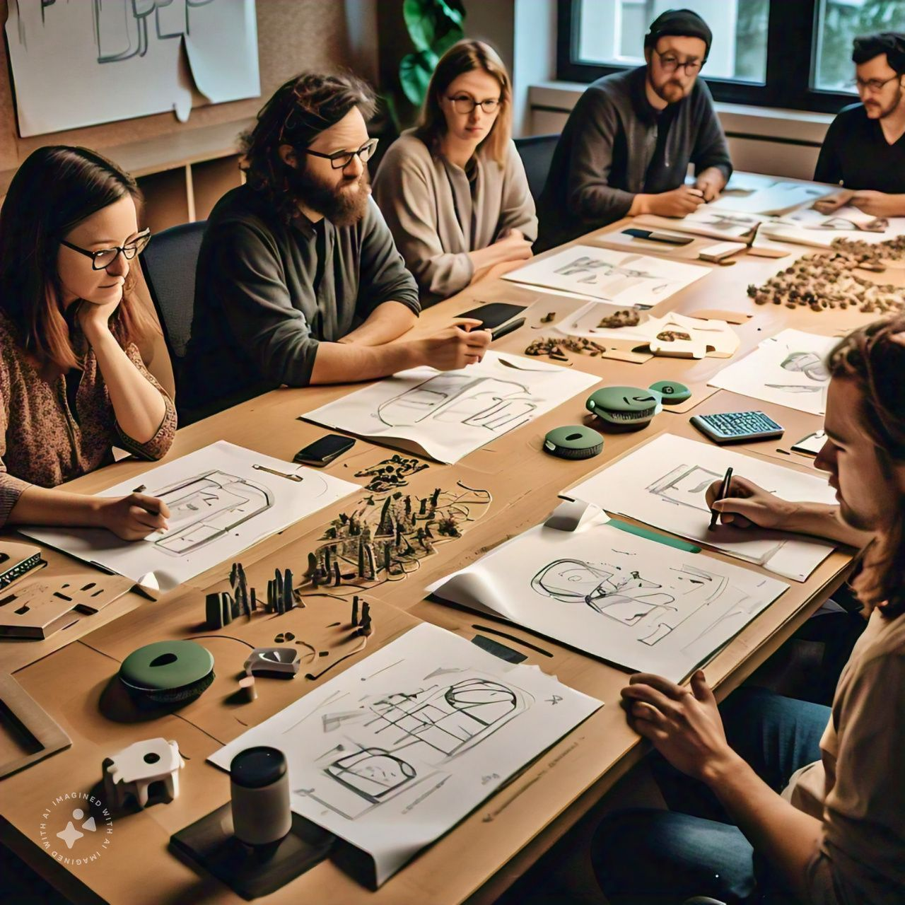
AGILE BOARD
1. Design Thinking
This phase focuses on deeply understanding the user’s needs, ideating solutions, and creating prototypes to test with real users.
Example: A team wants to create a fitness tracker app. Through interviews and observations, they identify that users need an app that not only tracks steps but also motivates them to exercise more. Based on this insight, the team brainstorms ideas like daily exercise challenges, calorie counters, and personalized fitness goals. They create low-fidelity prototypes (sketches, wireframes) and test these with users, collecting feedback to refine the app's design.
2.DEVELOPMENT
Agile development involves breaking down the app creation process into small, manageable iterations called sprints, where developers focus on building core functionalities. Feedback from users drives what gets prioritized.
Example: In the first sprint, the development team focuses on building a basic step counter and a dashboard that
displays daily steps. After each sprint (which typically lasts 2-4 weeks), the team reviews the results and gathers user feedback to see if the app works as intended. In the next sprints, they add features like tracking calories burned, setting fitness goals, and integrating the app with wearables (like smartwatches). Continuous testing and feedback loops ensure the app improves incrementally.

Slide 2
3. Marketing
In agile marketing, the marketing team promotes the app in parallel with its development, adjusting strategies based on user engagement and market trends.
Example: The marketing team starts by launching a campaign highlighting the fitness tracker app's key feature—step tracking—targeting health-conscious users on social media. They gather data on how users respond and make adjustments, perhaps shifting focus to emphasize newly added features like calorie tracking. The marketing team also coordinates with developers to promote future updates, like challenges or social sharing features, as these become available, keeping the user base engaged.

